Slide 1
Abstract Classes & Interfaces
By Alex Joslin

Slide 2
Class
Can have non-abstract methods (methods that are implemented)

Slide 3
Interface
Can only have abstract methods. (methods that are defined but unimplemented.)

Slide 4
Abstract classes
Can have both, non-abstract & abstract methods.

Slide 5
Rules
Any class that inherits from an Abstract Class or an Interface MUST implement their abstract methods.
A class can extend at most 1 abstract class
A class has no limit on the number of interfaces it can implement
Can’t create an instance of an Interface. (i.e creating an object from an interface.
By default, all methods in interfaces are public abstract.
By default, all variables in interfaces are public, final, and static.

Slide 6
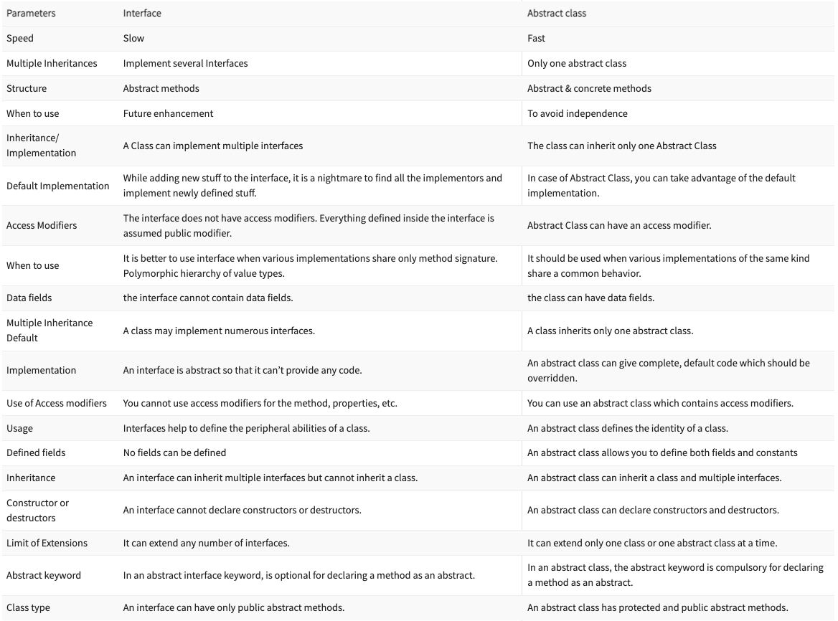

Slide 7
GameObject
(Abstract Class)
int x, y
string Name
getX()
getY()
setX()
setY()
talk()
IsVisible
(Interface)
setSprite()
showSprite()
Followable
(Interface)
setTarget()
Background
Player
Zombie
ZombieDog

